Slide 1
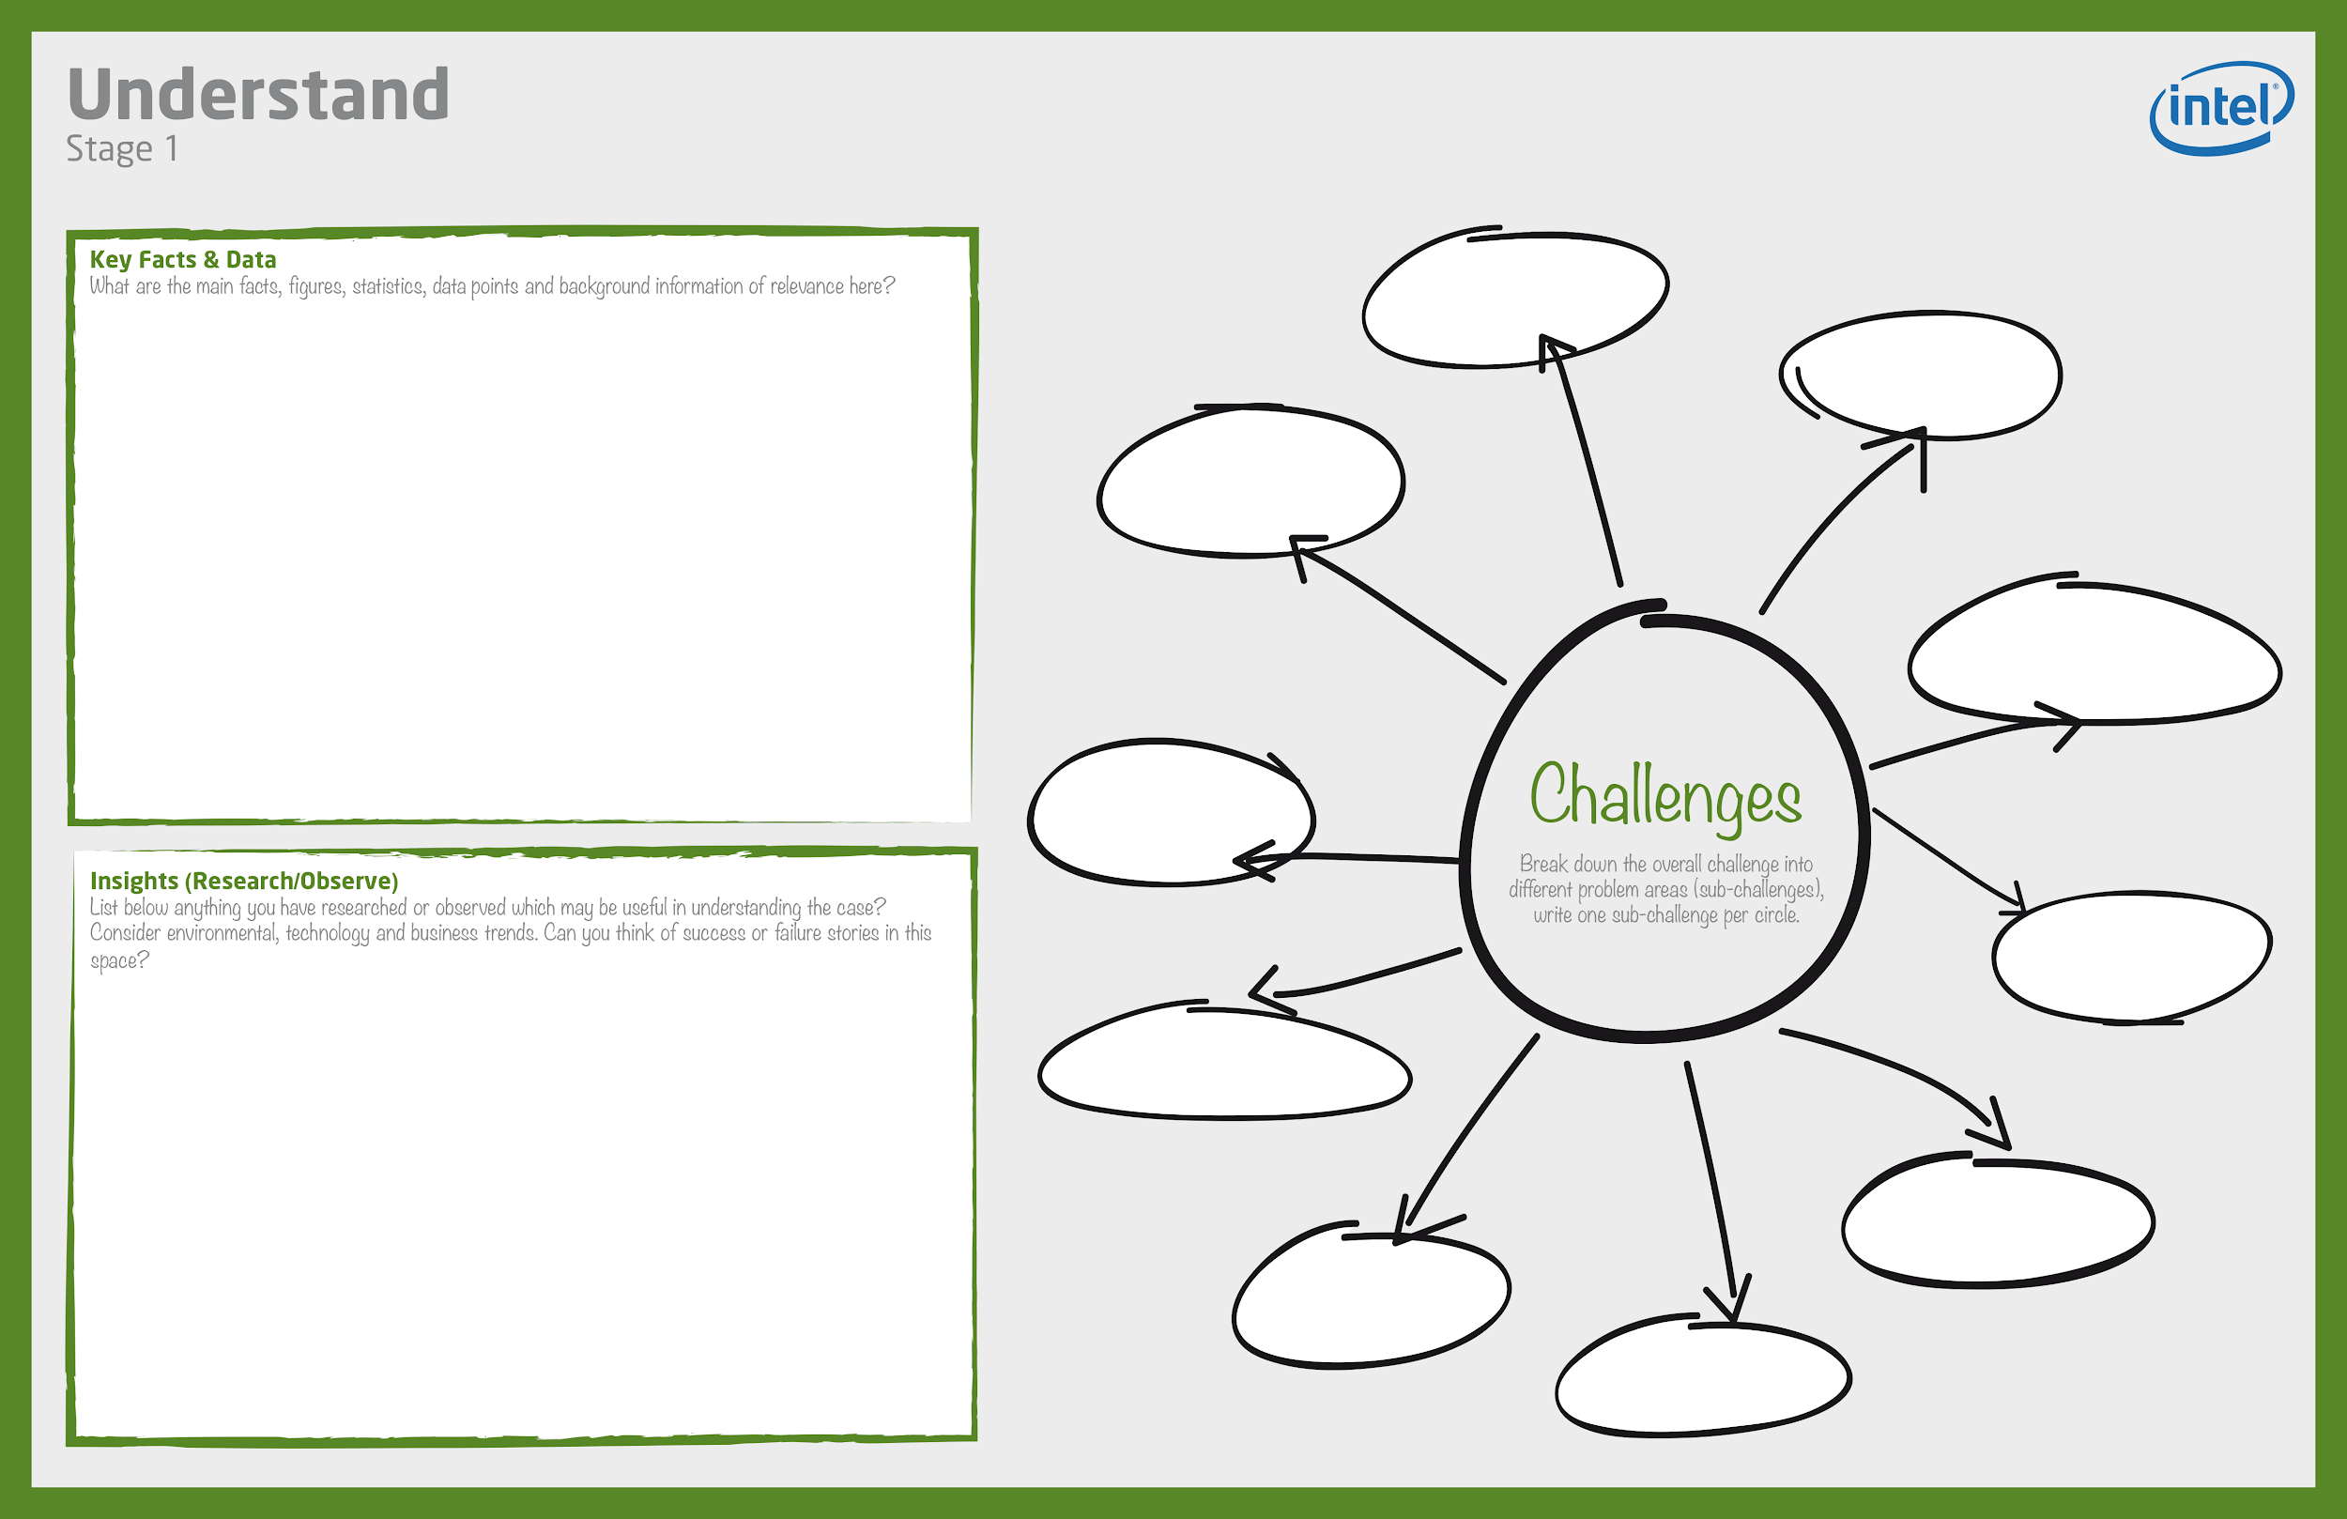
Team ID : GP22-094
Corona pandemic and Telehealth / remote patient monitoring .
In Egypt, the percent of elderly (65 years and above )in 2021 is 5.4% and is expected to become 15% by 2100.
The percentage of total deaths caused by
Coronary Heart Disease is 29.38% (early detected by Electrocardiogram)
Stroke is 10.7% (warning sign : Dizziness or problems with balance and Problems with movement or walking)
Coronavirus is 3.3% ( early treated by knowing blood oxygen levels and temperature) Falls is 0.76%
Encouraging investment and scientific research
Lack of hospitals' capacity
Provide healthy aging
providing high quality care with low costs
Building a strong database
Real-time health monitoring systems using IoT can help doctors prioritize patients, and provide urgent care to those who are in the most danger thereby saving lives.
Patients have welcomed the idea of remote healthcare system as it is easier and closer rather than going to a hospital.
Doctors were pleased to have such project as it allows them to follow patients' states more efficiently and monitor their conditions remotely.
More competent patient management can help utilize the resources of the hospital more wisely and save money. Thus, hospitals will have great benefit. Moreover, a great database for each patient will be created without traffic at the hospital, each patient from their home.
Early detection of diseases
Development of human resources
Guarantee a better life for people with disabilities
increase outreach programs about social health

